Slide 1


<Kaipeng Dong>
<Sep 18 2023>

Slide 2

Outline
Executive Summary
Introduction
Methodology
Results
Conclusion
Appendix

Slide 3
Executive Summary
Summary of methodologies
Data collection from CSV, webscrapping and Python, SQL
Data amendment: delete missing values.
EDA: Data visualization with scatter plots, bar charts
Predictive analysis
Summary of all results
Summary whole mission’s outcome
Prediction and results

Slide 4
Introduction
Project background and context
SpaceX advertises on its website that the launch cost of a Falcon 9 rocket is $62 million; The other vendors each cost more than $165 million, with most of the savings due to Space X's ability to reuse the first level. So if we can determine whether the first stage will land, we can determine the cost of the launch. This information could be used if another company wants to compete with SpaceX for rocket launches. This capstone project went through the whole process, eventually creating a machine learning pipeline that predicts whether the first stage will land based on data.
Problems you want to find answers
Our successful and meaningful finds
How about patterns, their influences

Slide 5

Section 1

Slide 6
Methodology
Executive Summary
Data collection methodology:
Data was collected with API and combined with Jupyter Notebook, and using Python analysis it.
Perform data wrangling
Identify the missing values and type of data, calculate several key information
Perform exploratory data analysis (EDA) using visualization and SQL
Perform interactive visual analytics using Folium and Plotly Dash
Perform predictive analysis using classification models
Explored launch sites, orbits, payloads and success rates

Slide 7
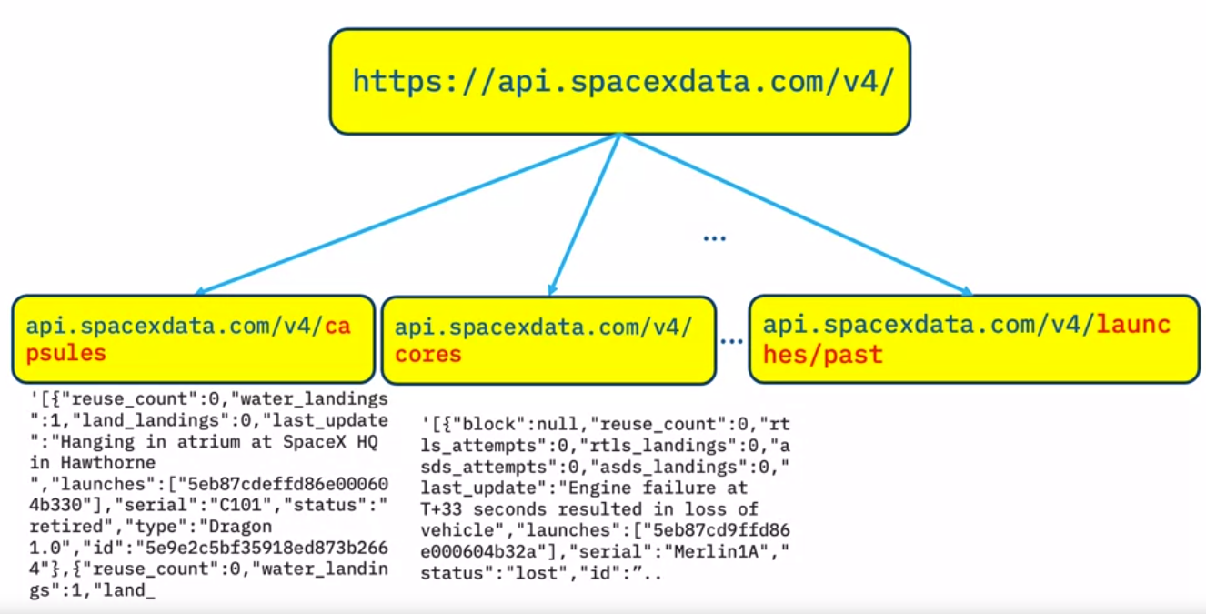
Data Collection
Describe how data sets were collected.
The data sets are collected via endpoints or urls from SpaceX's REST API that contain launch data and are collected from specific web pages via web scraping methods.
This endpoint is located by Python commands and loaded into the encoding environment as a csv(comma-separated values) file, which is then converted into a table that the language can manage.

Slide 8
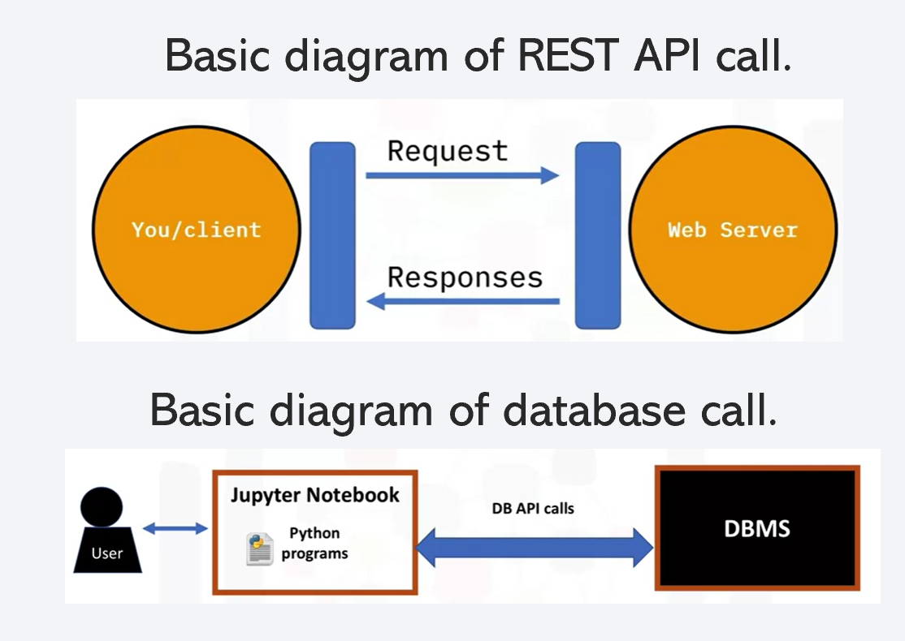
Data Collection – SpaceX API
The data is extracted from the SpaceX API using a request method, normalized, and a specific data frame is created using only Falcon 9 launches and certain columns. This includes checking, removing, and replacing missing values with averages where applicable.
Here is the external links for following steps: https://github.com/Kaipengdong/IBM-Data-Science-Final-Presentation

Slide 9
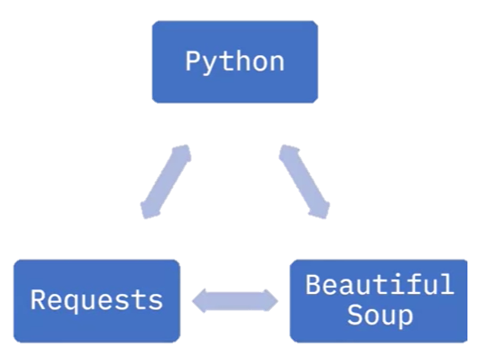
Data Collection - Scraping
A series of communication standards and functions from the library are structured and implemented to retrieve data from web pages (mainly tables) into Jupyter notebooks, where the data can be filtered, structured and calculated.
https://github.com/Kaipengdong/IBM-Data-Science-Final-Presentation

Slide 10
Data Wrangling
The main steps for processing data:
Deleting and replacing the missing values
Create new column or list with binary values
https://github.com/Kaipengdong/IBM-Data-Science-Final-Presentation

Slide 11
EDA with Data Visualization
Seaborn is used to explore the following relationships: classification between flight number/payload mass, payload mass/launch site scatter plot, flight number/track and payload mass /Orbit
Matplotlib for visualization: use bars, relationship between success rate and track type Use lines, annual trends in launch successAdd the GitHub URL of your completed EDA with data visualization notebook, as an external reference and peer-review purpose
https://github.com/Kaipengdong/IBM-Data-Science-Final-Presentation

Slide 12
EDA with SQL
The names of all the unique launch sites in the space mission
Records of launch sites beginning with "CCA“
Total payload mass carried by NASA (CRS) boosters
Average payload mass carried by F9 v1.1 booster
Date of the first successful landing on a ground pad
Boosters that successfully landed in a drone ship with payload
Total number of successful and failed mission outcomes
The name of booster versions which have carried the maximum payload
Records which show month names, failed landing outcomes in drone ships, booster versions, launch site name for the months
Rank the amount of successful landings in descending order
https://github.com/Kaipengdong/IBM-Data-Science-Final-Presentation

Slide 13
Build an Interactive Map with Folium
Each launch site has its own set of marker clusters showing the location of successful and failed launches to visually show the success rate of each launch site and its specific location.
Two lines were drawn from a launch site: one marking the nearest coastline and the other the intersection of the main highway.
It can show how far away they are from dangerous activities like launching rockets
https://github.com/Kaipengdong/IBM-Data-Science-Final-Presentation

Slide 14
Build a Dashboard with Plotly Dash
Here is a summary of the charts and interactions added to the dashboard:
Launch Site dropdown input components.
Brings back a pie chart of the tuner function, based on the sites selected from the drop-down input component.
Range slider select payload mass (kg).
Scatter plot success vs. payload.
These charts and interactions are added to enable stakeholders to explore and manipulate data in an interactive and real-time manner. In this way, interactive data visualizations can always tell a more engaging story than presenting the results in the form of static graphs.
https://github.com/Kaipengdong/IBM-Data-Science-Final-Presentation

Slide 15





Predictive Analysis (Classification)
Here's a summary of building, evaluating, improving, and finding the best-performing classification model:
Create a Numpy array from a selected column to perform model testing and evaluation.
Standardize data to keep ranges consistent.
Divide the data set into test subsets and training subsets.
Create objects for each fitted model and get the accuracy of each model.
https://github.com/Kaipengdong/IBM-Data-Science-Final-Presentation
Dataset Split: test & train
Train & test
Model
Predict
Accuracy

Slide 16
Results
Exploratory data analysis results
As the number of flights increases, the probability of successful first-stage landings increases. The mass of the payload is also important; It seems that the greater the load, the less likely it is that the first stage will return.
Interactive analytics demo in screenshots
The success rate has increased from 2013 to 2020
Predictive analysis results
Under heavy loads, successful or positive landing rates are more common in polar, low orbit and the International Space Station. However, for Gtos, we can't distinguish this very well because both the positive landing rate and the negative landing (failed missions) are here. Mission outcome

Slide 17

Section 2

Slide 18
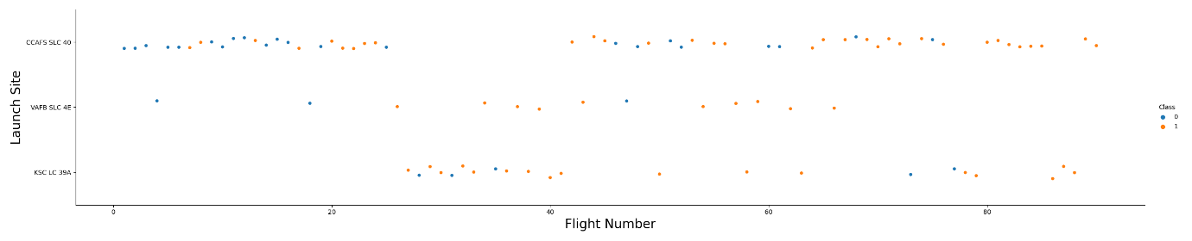
Flight Number vs. Launch Site
As it can be seen from the plot, the highest succes rate was from the launch site VAFB SLC 4E, followed by the KSC LC 39A and last CCAFS SLC 40. (Class 0 = failure, class 1 = success).

Slide 19
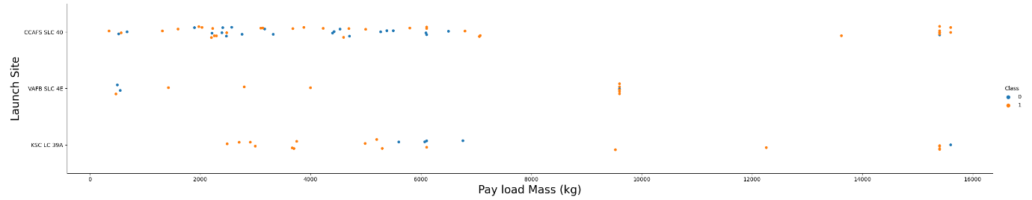
Payload vs. Launch Site
As it can be seen from the plot, generally speaking for big payload mass the success rate was bigger. (Class 0 = failure, class 1 = success).

Slide 20
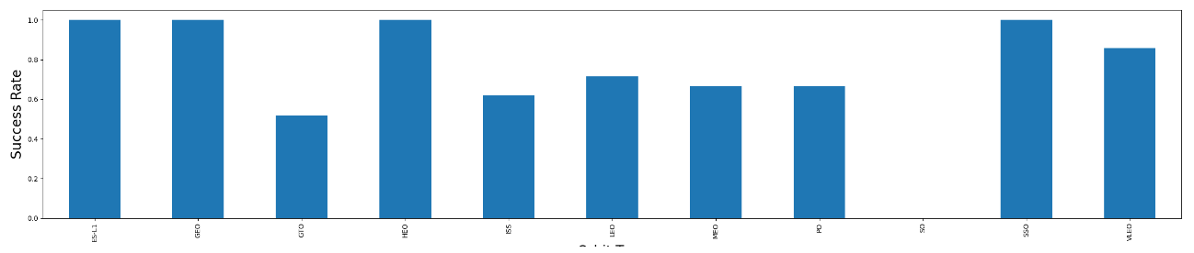
Success Rate vs. Orbit Type
As it can be seen from the plot, the orbits ES-L1, GFO, HEO. SSO and VLEO had the best success rate.

Slide 21
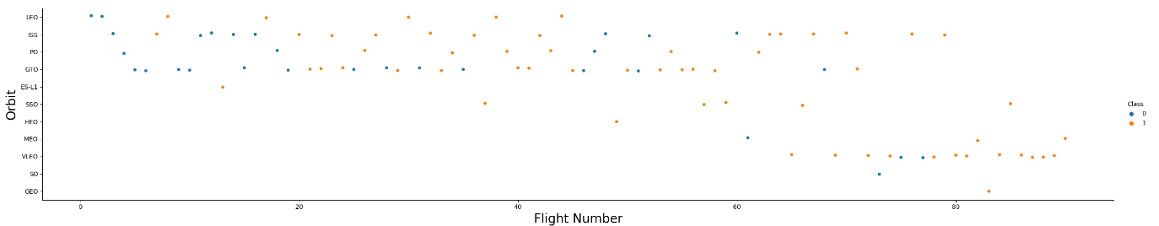
Flight Number vs. Orbit Type
As you can see from the graph, success in low Earth orbit seems to be related to the number of flights; On the other hand, on the GTO track, the flight number doesn't seem to matter.

Slide 22
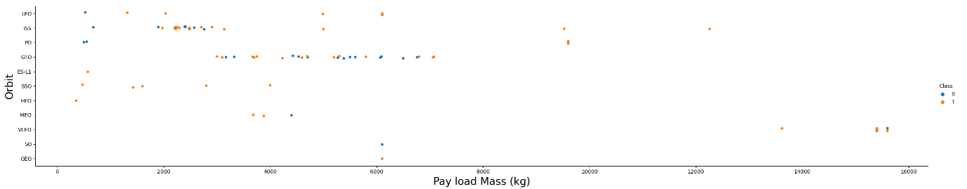
Payload vs. Orbit Type
As can be seen from the figure, successful or positive landing rates are higher for polar, low orbit and the International Space Station under heavy loads. However, for Gtos, we can't distinguish this very well because both the positive landing rate and the negative landing (failed missions) are here.

Slide 23
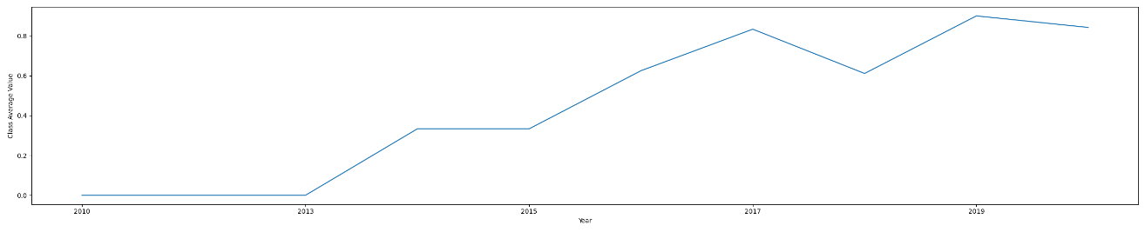
Launch Success Yearly Trend
As it can be seen from the plot, the success rate since 2013 kept increasing till 2020

Slide 24
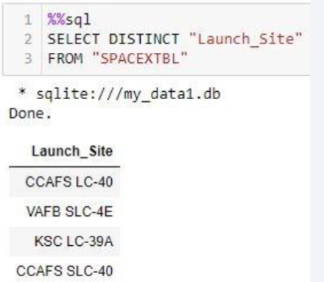
All Launch Site Names
Task: Find the names of the unique launch sites
The DISTINCT command was used to ensure only unique values would be calledPresent your query result with a short explanation here

Slide 25
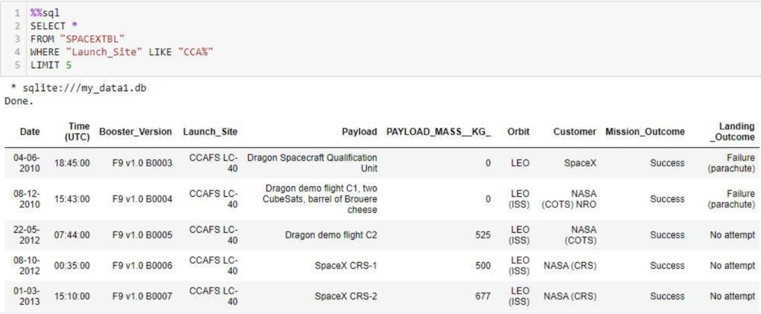
Launch Site Names Begin with 'CCA'
This query is used to retrieve all columns from SQL database and filter the column Launch_Site where the names begin with CCA by applying LIKE ‘CCA%’.
Query: %sql SELECT * FROM SPACEXTBL WHERE "Launch_Site" LIKE 'CCA%' LIMIT 5

Slide 26
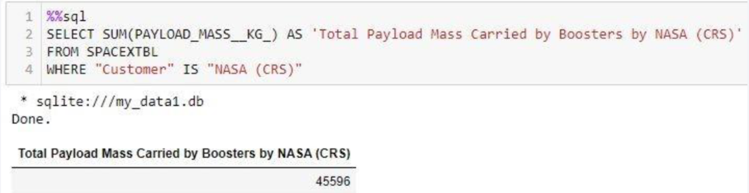
Total Payload Mass
Task: Calculate the total payload carried by boosters from NASA
Utilized the command SUM() to call the total payloadPresent your query result with a short explanation here

Slide 27
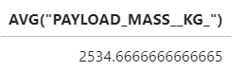
Average Payload Mass by F9 v1.1
The query uses AVG function to calculate de average of all values from the column PAYLOAD_MASS__KG_ where Booster_Version has the characters F9 v.1.1.

Slide 28
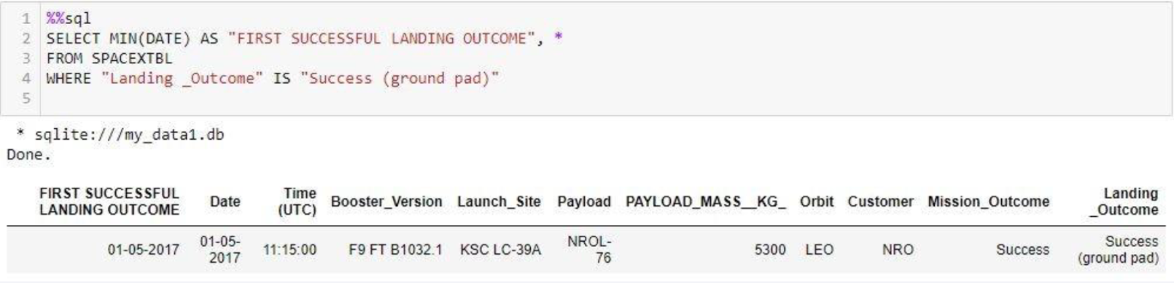
First Successful Ground Landing Date
The query uses MIN function to calculate de minimum vale from the column Date (first date) where Outcome = Success (ground pad).
Query: %sql SELECT MIN(Date) FROM SPACEXTBL WHERE "Landing _Outcome"="Success (ground pad)“

Slide 29
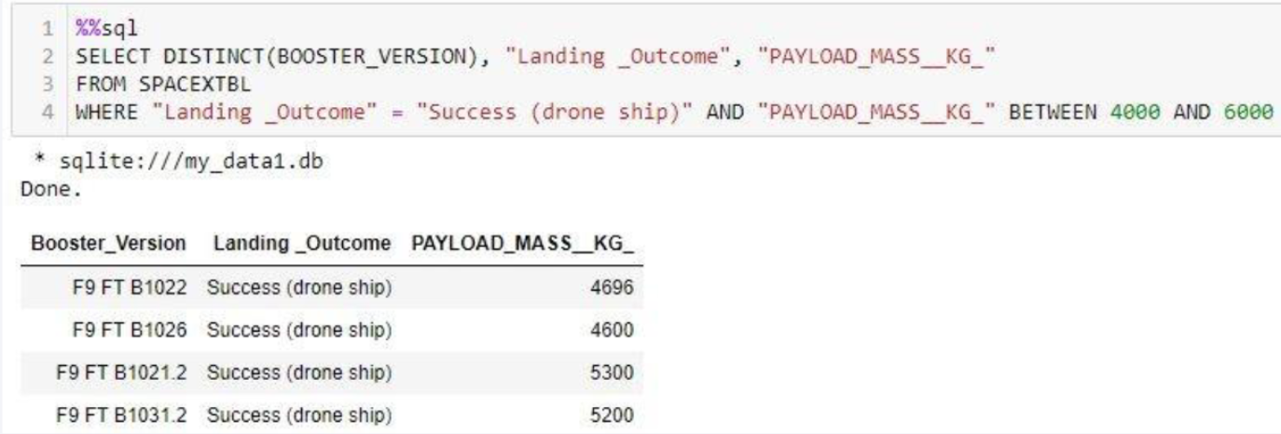
Successful Drone Ship Landing with Payload between 4000 and 6000
The query uses DISTINCT function retrieve unique values from Booster_Version column, with Landing_Outcome=Success and Payload between 4000 and 6000.
Query: %sql SELECT distinct "Booster_Version" FROM SPACEXTBL WHERE "Landing _Outcome"="Success (drone ship)" AND "PAYLOAD_MASS__KG_">4000 AND "PAYLOAD_MASS__KG_"<6000

Slide 30
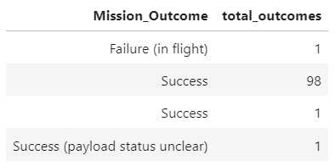
Total Number of Successful and Failure Mission Outcomes
The query selects the Mission outcome column and adds a column where it fills with the count of each case of mission outcome.
Query: %sql SELECT "Mission_Outcome", count(*) as total_outcomes FROM SPACEXTBL GROUP BY "Mission_Outcome“

Slide 31
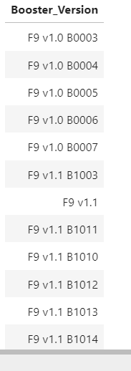
Boosters Carried Maximum Payload
The query selects unique values from Booster Version column and then uses a sub-query to select the max Payload Mass. (The table is very long, so a portion of it was included).
Query: %sql SELECT DISTINCT"Booster_Version" FROM SPACEXTBL where (select MAX(PAYLOAD_MASS__KG_) from SPACEXTBL)

Slide 32
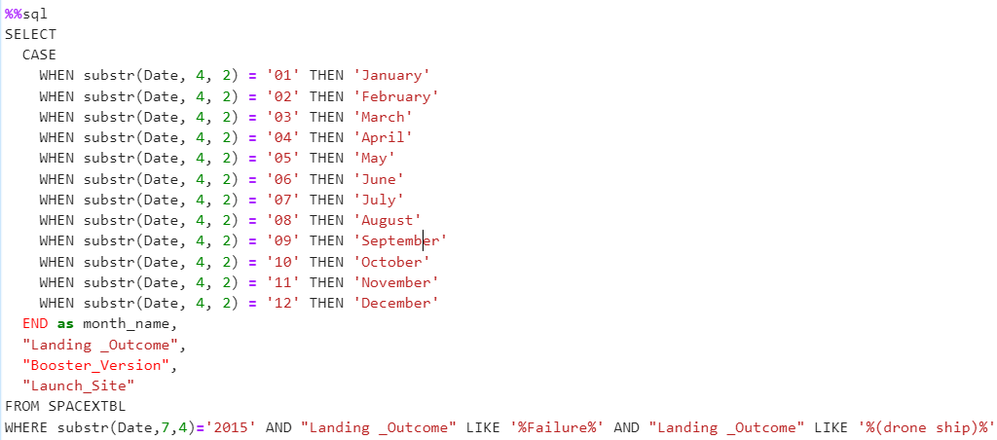
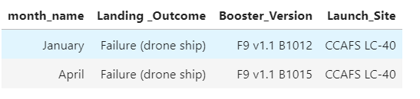
2015 Launch Records
The query uses a CASE function to translate number-type month date into letter-type month date, and filter: 2015 year failure launches, their bosster version and launch sites.

Slide 33
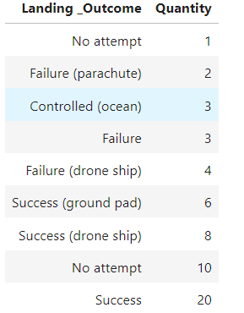
Rank Landing Outcomes Between 2010-06-04 and 2017-03-20
The query selects the Landing_Outcome column and counts the cases for the specified date range, groups it by Landing_Otume case and orders it by what was counted.
Query:%%sql
SELECT "Landing _Outcome", COUNT(*) as 'Quantity' FROM SPACEXTBL WHERE DATE BETWEEN '04-06-2010' AND '20-03- 2017’ GROUP BY "Landing _Outcome" ORDER BY "Quantity“

Slide 34

Section 3

Slide 35
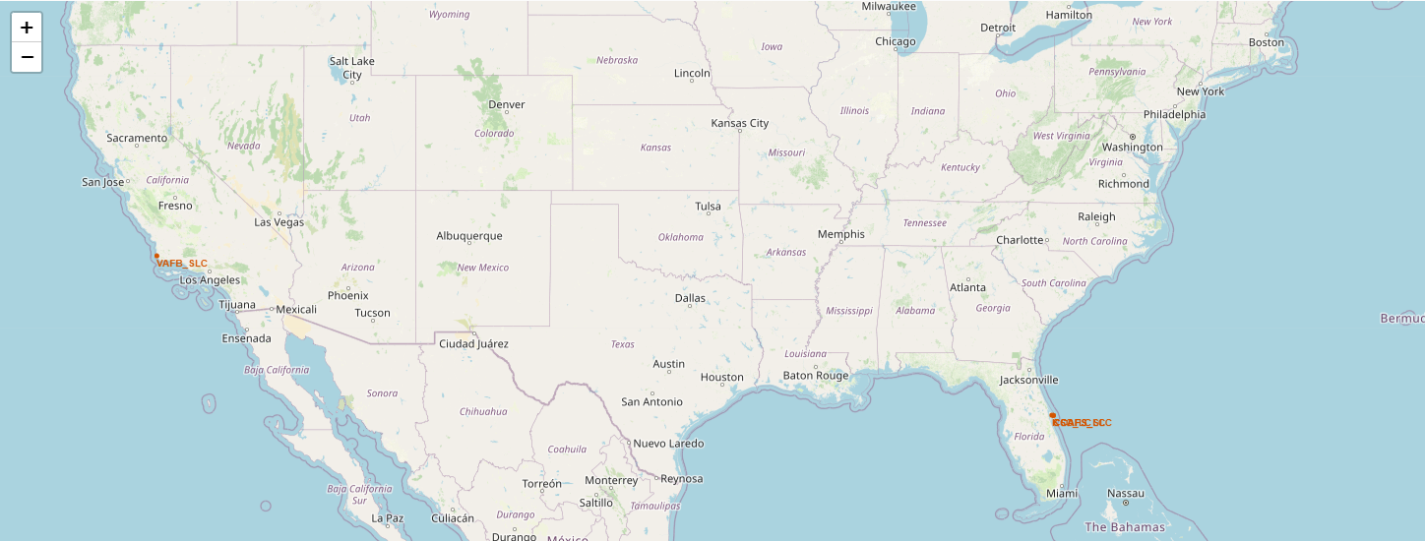
Falcon 9 SpaceX Launch Sites
Until now, for physical and cost reasons, SpaceX had two primary Falcon 9 launch sites: California and Florida, shown in red on the right side of the image.

Slide 36
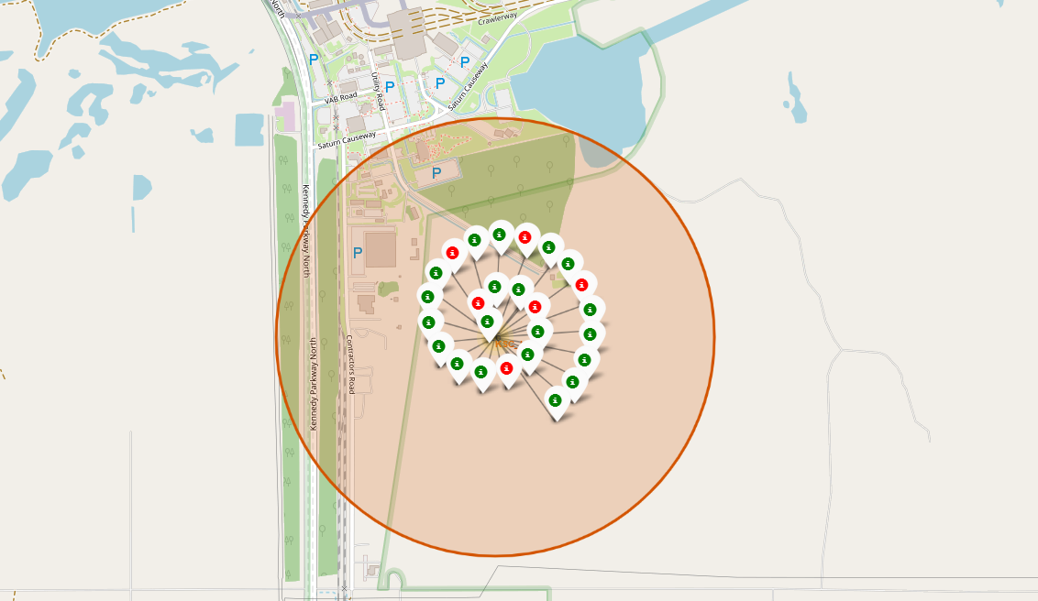
Map with markers, circles with success outcome.
To the right is the launch site in Florida. At the top, there is a green circle with the number 7 inside, which is CCAFS SLC-40. If you click on that number, it will open its marker cluster, as shown at the bottom, atCCAFS LC-40.
A green marker indicates a successful landing
A red marker indicates a failed landing

Slide 37
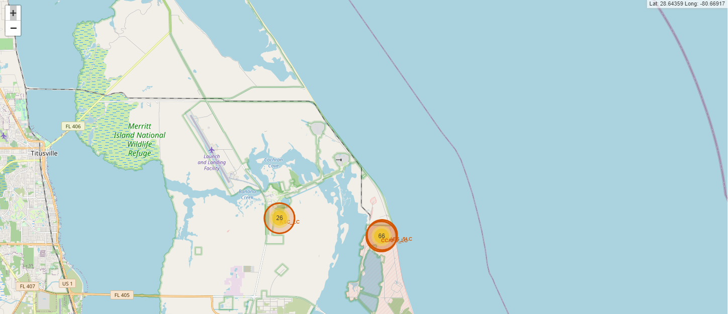
Map with markers, circles with success outcome and coordinates.
This map is the same as the one in the previous slide but it has a functionality that it indicates the coordinates as you move the mouse over the map for giving the instantaneous coordinate ion a specific point if the map.

Slide 38

Section 4

Slide 39
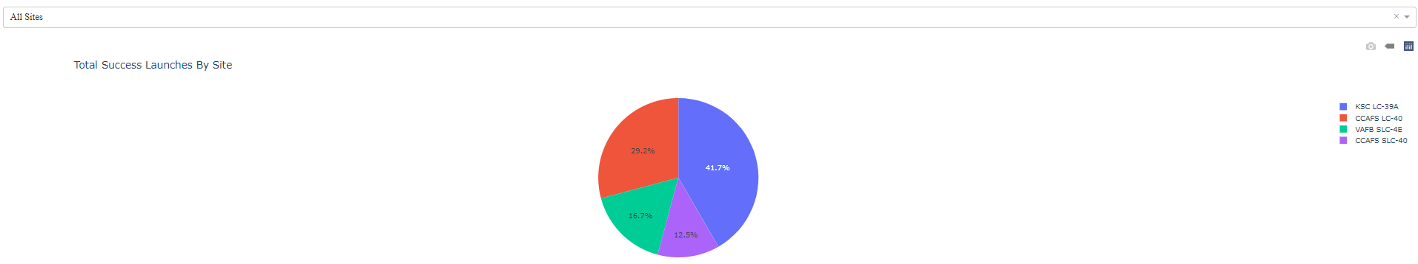
Successful count for all sites
A pie chart, below, giving a sense of the amount of successful launches by launch site, with KSC LC-39A leads with 41.7% success rate.

Slide 40
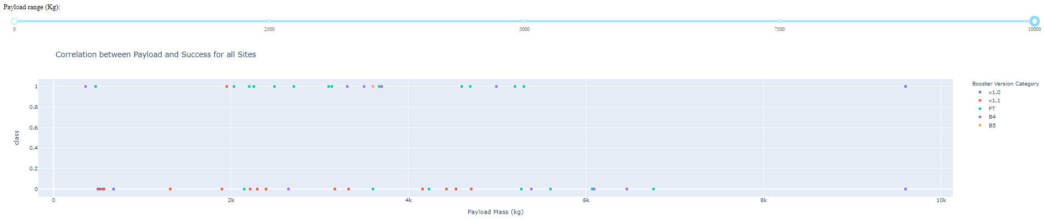
Payload vs. Launch Outcome scatter plot
This scatter plot shows the correlation between Payload mass and launch outcome. The range slider is very useful because it can filter the payload mass range for a desired one and get instant insightful information.

Slide 41

Section 5

Slide 42
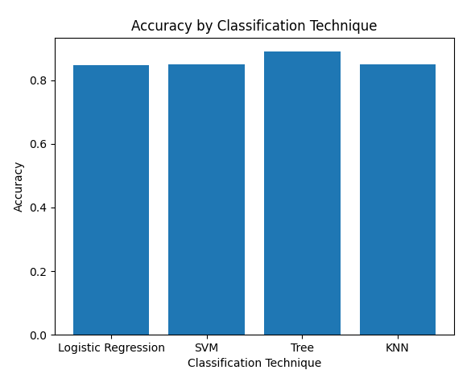
Classification Accuracy
By comparing the accuracy of each model, we found that the tree classification technique was the most suitable, although the other methods were not very different.

Slide 43
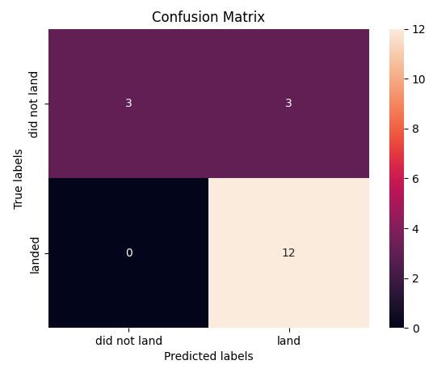
Confusion Matrix
The confusion matrix of the decision tree technique is shown, which reveals that for actual landing events, the model predicts all cases, and for actual events that do not land, the model predicts half of them.

Slide 44
Conclusions
As the number of flights increases, the probability of successful first-stage landings increases. The mass of the payload is also important; It seems that the greater the load, the less likely it is that the first stage will return.
For the VAFB-SLC launch site, there are no rockets launched with a heavy payload mass (greater than 10,000), which in general has a high success rate.
Under heavy loads, successful or positive landing rates are more common in polar, low orbit and the International Space Station. However, for Gtos, we can't distinguish this very well because both the positive landing rate and the negative landing (failed missions) are here.
From 2013 to 2020, the success rate continues to rise.
All missions have a very high success rate.
Decision tree technique is the best technique for this model.

Slide 45
Appendix
https://github.com/Kaipengdong/IBM-Data-Science-Final-Presentation

Slide 46


